Slide 1
Floating Point

Slide 2
Introduction
programming languages support numbers with fractions, which are called reals in mathematics
A number in scientific notation that has no leading 0s is called a normalized number.
For example, 1.0_{ten} X 10⁻⁹ is in normalized scientific notation.
Just as we can show decimal numbers in scientific notation, we can also show binary numbers in scientific notation
1.0_{two} X 2⁻¹
Since the base is not 10, we need a new name and in computer arithmetic that is called as floating point.

Slide 3

Floating Point Representation
Floating-point numbers are usually a multiple of the size of a word. The representation of a MIPS floating-point number is shown below.
These chosen sizes of exponent and fraction give MIPS computer arithmetican extraordinary range.

Slide 4
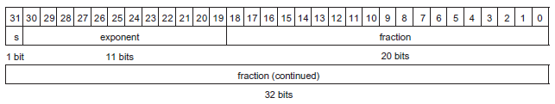
Contd.,
The representation of a double precision floating-point number takes two MIPS words, as shown below.
In general, floating-point numbers are of the form
(-1)^{S} X F X 2E
F involves the value in the fraction field and E involves the value in the exponent field.

Slide 5
Example.
Show the IEEE 754 binary representation of the number 263.3 in single precision.
Let us watch a video to understand it better.
Link: https://youtu.be/8afbTaA-gOQ

Slide 6
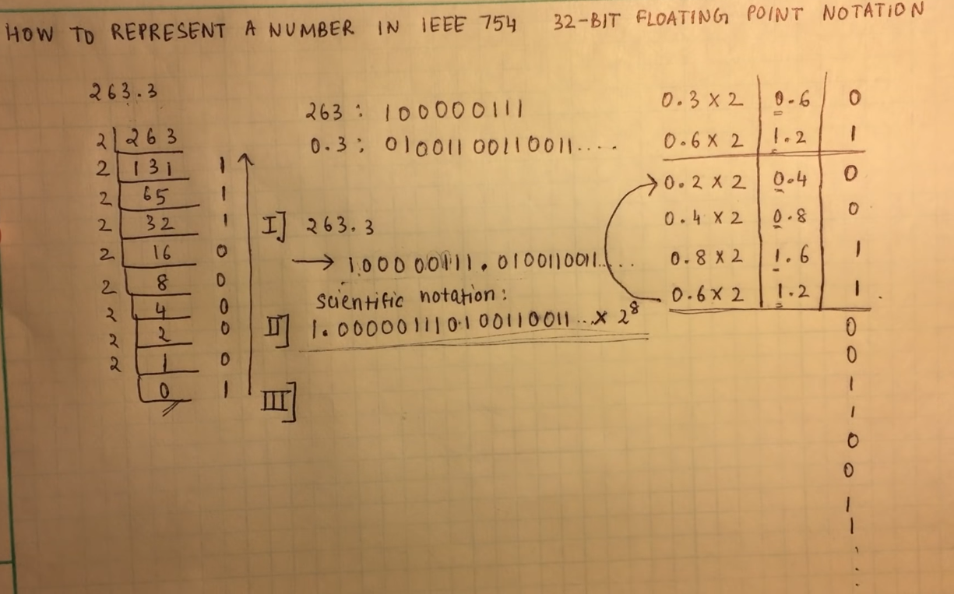
Step 1 and 2

Slide 7
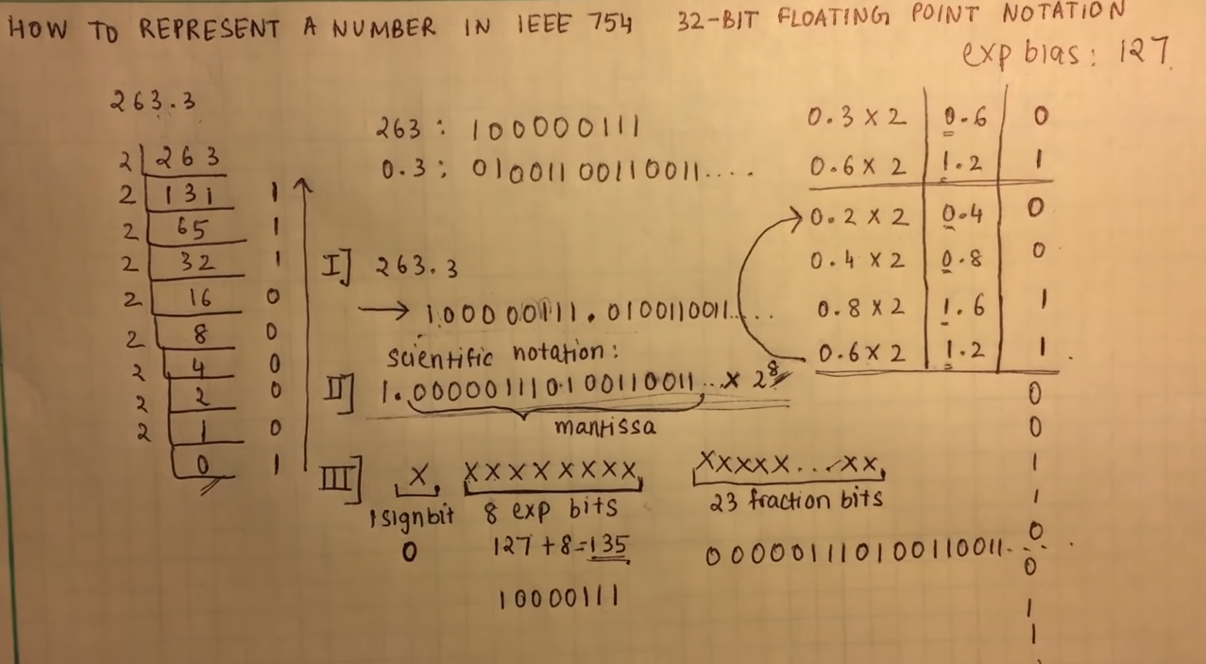
Step 3
Result: 0100 0011 1000 0011 1010 0110 0110 0110

Slide 8
Contd.,
Example: Show the IEEE 754 binary representation of the number 45.45 in single precision.
Note: The exponent bias for single precision is 127
The exponent bias for double precision is 1023
Example: Show the IEEE 754 binary representation of the number A0F9.0EB₁₆ in double precision.

